Slide 1
Chapter Two
Design Patterns

Slide 2
What are design patterns
In software engineering, a design pattern is a general repeatable solution to a commonly occurring problem in software design.
A design pattern isn't a finished design that can be transformed directly into code. It is a description or template for how to solve a problem that can be used in many different situations.
Design patterns can speed up the development process by providing tested, proven development paradigms.
Effective software design requires considering issues that may not become visible until later in the implementation.
Reusing design patterns helps to prevent subtle issues that can cause major problems and improves code readability for coders and architects familiar with the patterns.

Slide 3
Cont…
Often, people only understand how to apply certain software design techniques to certain problems.
Design patterns provide general solutions, documented in a format that doesn't require specifics tied to a particular problem.
A design patterns are well-proved solution for solving the specific problem/task.
In addition, patterns allow developers to communicate using well-known, well understood names for software interactions.

Slide 4
Cont…
design patterns are programming language independent strategies for solving the common object-oriented design problems. That means, a design pattern represents an idea, not a particular implementation.
By using the design patterns you can make your code more flexible, reusable and maintainable.
use the design patterns during the analysis and requirement phase of SDLC(Software Development Life Cycle).
Design patterns can be categorized into three main types based on their purpose and area of focus: Creational Patterns, Structural Patterns and Behavioral Patterns

Slide 5
Advantage of design pattern:
They are reusable in multiple projects.
They provide the solutions that help to define the system architecture.
They provide transparency to the design of an application.
They are well-proved and testified solutions since they have been built upon the knowledge and experience of expert software developers.
Design patterns don’t guarantee an absolute solution to a problem. They provide clarity to the system architecture and the possibility of building a better system.

Slide 6
Creational design patterns
Creational design patterns are concerned with the way of creating objects.
These design patterns are used when a decision must be made at the time of instantiation of a class (i.e. creating an object of a class).
These design patterns are all about class instantiation.
This pattern can be further divided into class-creation patterns and object-creational patterns.
While class-creation patterns the process of creating instances of classes, object-creation patterns focused on the process of creating individual objects within a program. Examples of object-creation patterns include Prototype Pattern, Object Pool Pattern

Slide 7
Cont…
Some common creational design patterns:
Factory Method- Defines an interface for creating objects in a superclass but allows subclasses to alter the type of objects that will be created.
Abstract Factory- Creates an instance of several families of classes.
Singleton- A class of which only a single instance can exist
Prototype- A fully initialized instance to be copied or cloned
Builder - Separates object construction from its representation
Object Pool- Avoid expensive acquisition and release of resources by recycling objects that are no longer in use

Slide 8
Factory Method Pattern
A Factory Pattern or Factory Method Pattern says that just define an interface or abstract class for creating an object but let the subclasses decide which class to instantiate.
In other words, subclasses are responsible to create the instance of the class.
The Factory Method Pattern is also known as Virtual Constructor.
Advantage of Factory Design Pattern
Factory Method Pattern allows the sub-classes to choose the type of objects to create.
It promotes the loose-coupling by eliminating the need to bind application specific classes into the code.

Slide 9
Usage of Factory Design Pattern
When a class doesn't know what sub-classes will be required to create
When a class wants that its sub-classes specify the objects to be created.
When the parent classes choose the creation of objects to its sub-classes.

Slide 10
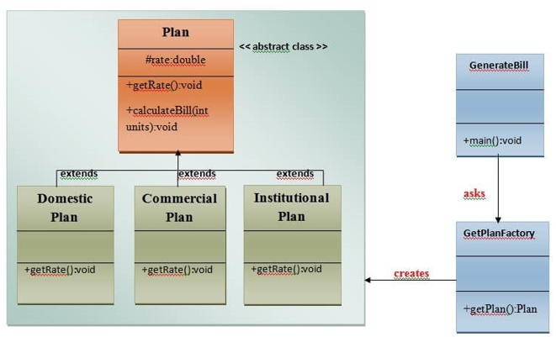
UML for Factory Method Pattern
We are going to create a Plan abstract class and concrete classes that extends the Plan abstract class. A factory class GetPlanFactory is defined as a next step.
Calculate Electricity Bill : GenerateBill class will use GetPlanFactory to get a Plan object. It will pass information (DOMESTICPLAN / COMMERCIALPLAN / INSTITUTIONALPLAN) to GetPalnFactory to get the type of object it needs.

Slide 11
Abstract Factory Pattern
Abstract Factory Pattern says that just define an interface or abstract class for creating families of related (or dependent) objects but without specifying their concrete sub-classes.
That means Abstract Factory lets a class returns a factory of classes. So, this is the reason that Abstract Factory Pattern is one level higher than the Factory Pattern.
An Abstract Factory Pattern is also known as Kit.
Advantage of Abstract Factory Pattern
Abstract Factory Pattern isolates the client code from concrete (implementation) classes.
It eases the exchanging of object families.
It promotes consistency among objects

Slide 12
Usage of Abstract Factory Pattern
When the system needs to be independent of how its object are created, composed, and represented.
When the family of related objects has to be used together, then this constraint needs to be enforced.
When the system needs to be configured with one of a multiple family of objects.

Slide 13
UML for Abstract Factory Pattern
We are going to create a Bank interface and a Loan abstract class as well as their sub-classes.
Then we will create AbstractFactory class as next step.
Then after we will create concrete classes, BankFactory, and LoanFactory that will extends AbstractFactory class
After that, AbstractFactoryPatternExample class uses the FactoryCreator to get an object of AbstractFactory class.
See the diagram carefully is given below:

Slide 14
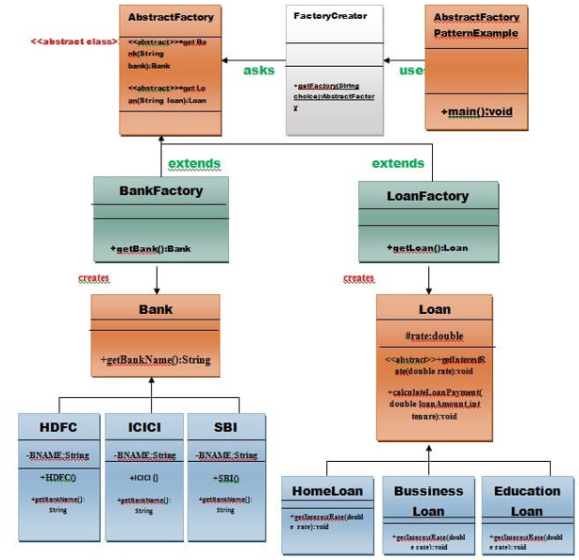
Cont…

Slide 15
Singleton design pattern
Singleton Pattern says that just "define a class that has only one instance and provides a global point of access to it".
In other words, a class must ensure that only single instance should be created and single object can be used by all other classes.
There are two forms of singleton design pattern
Early Instantiation: creation of instance at load time.
Lazy Instantiation: creation of instance when required.
Advantage of Singleton design pattern
Saves memory because object is not created at each request. Only single instance is reused again and again

Slide 16
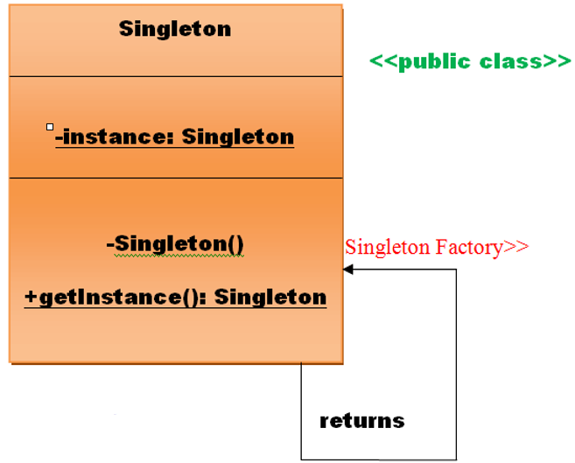
UML of Singleton design pattern

Slide 17
How to create Singleton design pattern?
To create the singleton class, we need to have static member of class, private constructor and static factory method.
Static member: It gets memory only once because of static, it contains the instance of the Singleton class.
Private constructor: It will prevent to instantiate the Singleton class from outside the class.
Static factory method: This provides the global point of access to the Singleton object and returns the instance to the caller.

Slide 18
Cont…
Let's see the example of singleton design pattern using early instantiation.
File: A.java
class A{
private static A obj=new A();//Early, instance will be created at load time
private A(){}
public static A getA(){
return obj;
}
public void doSomething(){
//write your code
}
}

Slide 19
Prototype Design Pattern
Prototype Pattern says that cloning of an existing object instead of creating new one and can also be customized as per the requirement.
This pattern should be followed, if the cost of creating a new object is expensive and resource intensive.
The main advantages of prototype pattern are as follows:
It reduces the need of sub-classing.
It hides complexities of creating objects.
The clients can get new objects without knowing which type of object it will be.

Slide 20
Usage of Prototype Pattern
When the classes are instantiated at runtime.
When the cost of creating an object is expensive or complicated.
When you want to keep the number of classes in an application minimum.
When the client application needs to be unaware of object creation and representation.

Slide 21
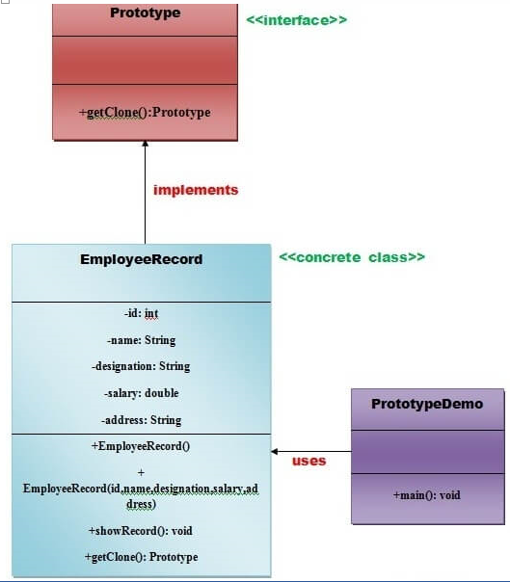
UML for Prototype Pattern

Slide 22
Cont…
We are going to create an interface Prototype that contains a method getClone() of Prototype type.
Then, we create a concrete class EmployeeRecord which implements Prototype interface that does the cloning of EmployeeRecord object.
PrototypeDemo class will uses this concrete class EmployeeRecord.

Slide 23
Builder Design Pattern
Builder Pattern says that "construct a complex object from simple objects using step-by-step approach"
It is mostly used when object can't be created in single step like in the de-serialization of a complex object.
Advantage of Builder Design Pattern
It provides clear separation between the construction and representation of an object.
It provides better control over construction process.
It supports to change the internal representation of objects.

Slide 24
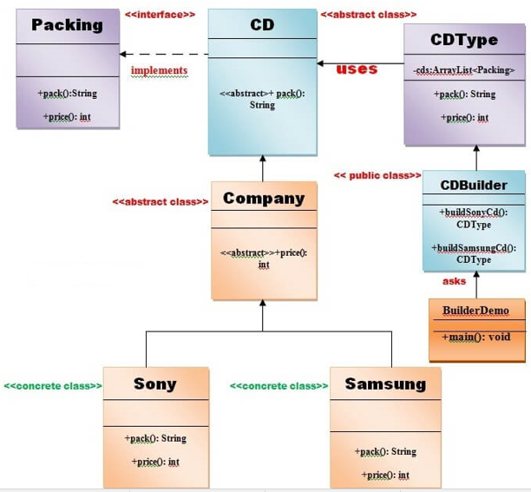
UML for Builder Pattern Example

Slide 25
Cont…
Example of Builder Design Pattern
To create simple example of builder design pattern, you need to follow 6 following steps.
Create Packing interface
Create 2 abstract classes CD and Company
Create 2 implementation classes of Company: Sony and Samsung
Create the CDType class
Create the CDBuilder class
Create the BuilderDemo class

Slide 26
Object Pool Pattern
Object Pool Pattern says that " to reuse the object that are expensive to create".
Basically, an Object pool is a container which contains a specified amount of objects. When an object is taken from the pool, it is not available in the pool until it is put back. Objects in the pool have a lifecycle: creation, validation and destroy.
A pool helps to manage available resources in a better way. There are many using examples: especially in application servers there are data source pools, thread pools etc.

Slide 27
Advantage of Object Pool design pattern
It boosts the performance of the application significantly.
It is most effective in a situation where the rate of initializing a class instance is high.
It manages the connections and provides a way to reuse and share them.
It can also provide the limit for the maximum number of objects that can be created.
Usage:
When an application requires objects which are expensive to create. Eg: there is a need of opening too many connections for the database then it takes too longer to create a new one and the database server will be overloaded.
When there are several clients who need the same resource at different times.

Slide 28
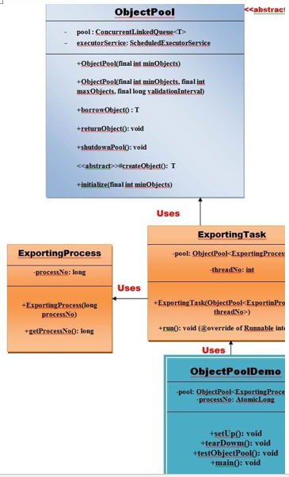
UML for Object Pool Pattern

Slide 29
Structural design patterns
Structural design patterns are concerned with how classes and objects can be composed, to form larger structures.
The structural design patterns simplifies the structure by identifying the relationships.
These patterns focus on, how the classes inherit from each other and how they are composed from other classes.
These design patterns are all about Class and Object composition.
Structural object-patterns define ways to compose objects to obtain new functionality.

Slide 30
Types of structural design patterns
There are following 7 types of structural design patterns.
Adapter Pattern - Adapting an interface into another according to client expectation.
Bridge Pattern - Separating abstraction (interface) from implementation.
Composite Pattern - Allowing clients to operate on hierarchy of objects.
Decorator Pattern - Adding functionality to an object dynamically.
Facade Pattern - Providing an interface to a set of interfaces.
Flyweight Pattern - Reusing an object by sharing it.
proxy Pattern - Representing another object.

Slide 31
Adapter Pattern
An Adapter Pattern says that just "converts the interface of a class into another interface that a client wants".
In other words, to provide the interface according to client requirement while using the services of a class with a different interface.
The Adapter Pattern is also known as Wrapper.
Advantage of Adapter Pattern
It allows two or more previously incompatible objects to interact.
It allows reusability of existing functionality.

Slide 32
Cont…
It is used:
When an object needs to utilize an existing class with an incompatible interface.
When you want to create a reusable class that cooperates with classes which don't have compatible interfaces.

Slide 33
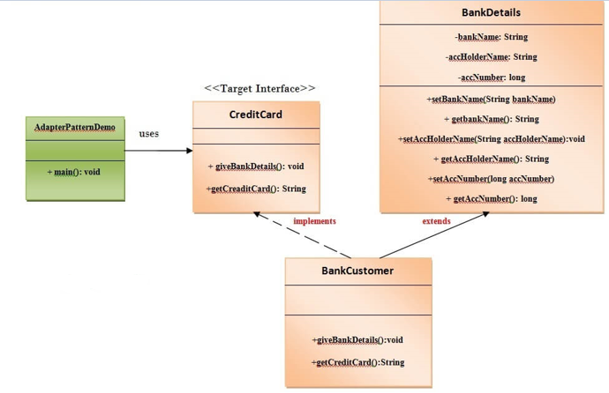
Cont…
UML for Adapter Pattern

Slide 34
Bridge Pattern
A Bridge Pattern says that just "decouple the functional abstraction from the implementation so that the two can vary independently".
The Bridge Pattern is also known as Handle or Body.
Advantage of Bridge Pattern
It enables the separation of implementation from the interface.
It improves the extensibility.
It allows the hiding of implementation details from the client.

Slide 35
Con…
Usage of Bridge Pattern
When you don't want a permanent binding between the functional abstraction and its implementation.
When both the functional abstraction and its implementation need to extended using sub-classes.
It is mostly used in those places where changes are made in the implementation does not affect the clients.

Slide 36
Composite Pattern
Compose objects into tree structures to represent whole-part hierarchies.
Composite lets clients treat individual objects and compositions of objects uniformly.
Recursive composition
1-to-many "has a" up the "is a" hierarchy

Slide 37
Cont…
It is used:
When you want to represent a full or partial hierarchy of objects.
When the responsibilities are needed to be added dynamically to the individual objects without affecting other objects. Where the responsibility of object may vary from time to time.

Slide 38
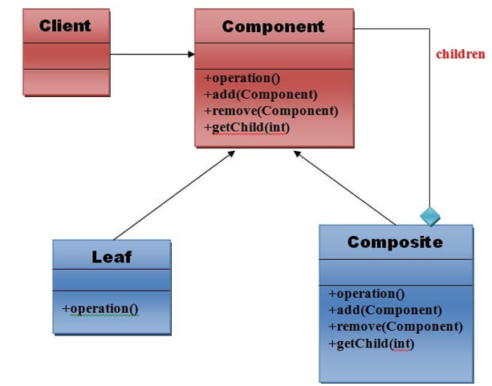
Cont…
UML for Composite Pattern

Slide 39
Cont…
Elements used in Composite Pattern: the 4 elements of composite pattern.
1) Component
Declares interface for objects in composition.
Implements default behavior for the interface common to all classes as appropriate.
Declares an interface for accessing and managing its child components.
2) Leaf
Represents leaf objects in composition. A leaf has no children.
Defines behavior for primitive objects in the composition.
3) Composite
Defines behavior for components having children.
Stores child component.
Implements child related operations in the component interface.
4) Client
Manipulates objects in the composition through the component interface.

Slide 40
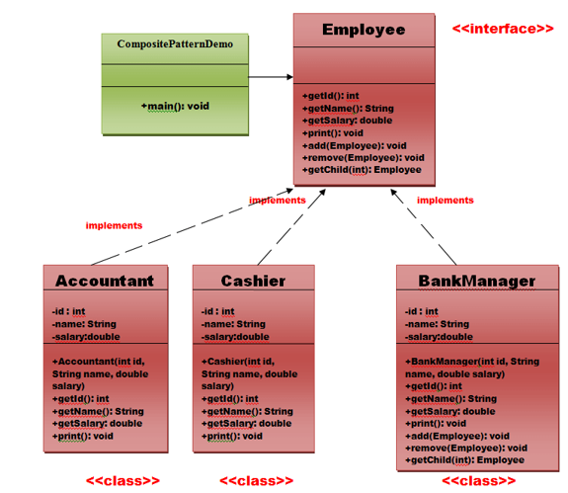
Cont…
Example of Composite Pattern

Slide 41
Decorator Pattern
A Decorator Pattern says that just "attach a flexible additional responsibilities to an object dynamically".
In other words, The Decorator Pattern uses composition instead of inheritance to extend the functionality of an object at runtime.
Advantage of Decorator Pattern
It provides greater flexibility than static inheritance.
It enhances the extensibility of the object, because changes are made by coding new classes.
It simplifies the coding by allowing you to develop a series of functionality from targeted classes instead of coding all of the behavior into the object.

Slide 42
Cont…
It is used:
When you want to transparently and dynamically add responsibilities to objects without affecting other objects.
When you want to add responsibilities to an object that you may want to change in future.
Extending functionality by sub-classing is no longer practical.

Slide 43
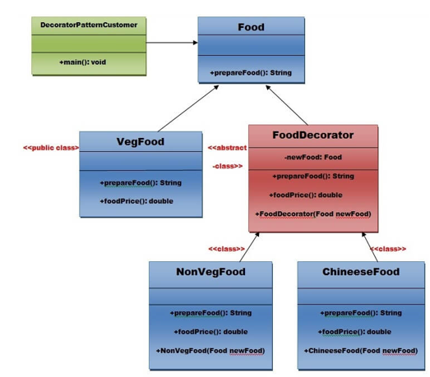
Cont…
Example

Slide 44
Facade Pattern
A Facade Pattern says that just "just provide a unified and simplified interface to a set of interfaces in a subsystem, therefore it hides the complexities of the subsystem from the client".
In other words, Facade Pattern describes a higher-level interface that makes the sub-system easier to use.
Practically, every Abstract Factory is a type of Facade.
Advantage of Facade Pattern
It shields the clients from the complexities of the sub-system components.
It promotes loose coupling between subsystems and its clients.

Slide 45
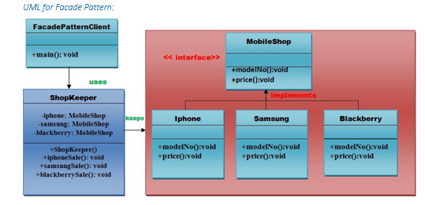
Cont…
It is used:
When you want to provide simple interface to a complex sub-system.
When several dependencies exist between clients and the implementation classes of an abstraction.

Slide 46
Flyweight Pattern
A Flyweight Pattern says that just "to reuse already existing similar kind of objects by storing them and create new object when no matching object is found".
Advantage of Flyweight Pattern
It reduces the number of objects.
It reduces the amount of memory and storage devices required if the objects are persisted
Usage of Flyweight Pattern
When an application uses number of objects
When the storage cost is high because of the quantity of objects.
When the application does not depend on object identity.

Slide 47
Proxy Pattern
Provide a replacement or placeholder for another object to control access to it.
Use an extra level of indirection to support distributed, controlled, or intelligent access.
Add a wrapper and delegation to protect the real component from unnecessary complexity.

Slide 48
Proxy Pattern
Usage of Proxy Pattern:
It can be used in Virtual Proxy scenario---Consider a situation where there is multiple database call to extract huge size image. Since this is an expensive operation so here we can use the proxy pattern which would create multiple proxies and point to the huge size memory consuming object for further processing. The real object gets created only when a client first requests/accesses the object and after that we can just refer to the proxy to reuse the object. This avoids duplication of the object and hence saving memory.
It can be used in Protective Proxy scenario---It acts as an authorization layer to verify that whether the actual user has access the appropriate content or not. For example, a proxy server which provides restriction on internet access in office. Only the websites and contents which are valid will be allowed and the remaining ones will be blocked.
It can be used in Remote Proxy scenario---A remote proxy can be thought about the stub in the RPC call. The remote proxy provides a local representation of the object which is present in the different address location. Another example can be providing interface for remote resources such as web service or REST resources.
It can be used in Smart Proxy scenario---A smart proxy provides additional layer of security by interposing specific actions when the object is accessed. For example, to check whether the real object is locked or not before accessing it so that no other objects can change it.

Slide 49
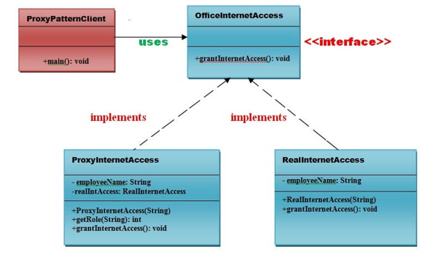
Cont…
UML for Proxy Pattern:

Slide 50
Behavioral Design Patterns
Behavioral design patterns are concerned with the interaction and responsibility of objects.
In these design patterns, the interaction between the objects should be in such a way that they can easily talk to each other and still should be loosely coupled.
That means the implementation and the client should be loosely coupled in order to avoid hard coding and dependencies.

Slide 51
Cont…
There are 12 types of behavioral design patterns:
Chain of Responsibility Pattern
Command Pattern
Interpreter Pattern
Iterator Pattern
Mediator Pattern
Memento Pattern
Observer Pattern
State Pattern
Strategy Pattern
Template Pattern
Visitor Pattern
Null Object

Slide 52
Chain of Responsibility Pattern
In chain of responsibility, sender sends a request to a chain of objects. The request can be handled by any object in the chain.
A Chain of Responsibility Pattern says that just "avoid coupling the sender of a request to its receiver by giving multiple objects a chance to handle the request". For example, an ATM uses the Chain of Responsibility design pattern in money giving process.
In other words, each receiver contains reference of another receiver. If one object cannot handle the request then it passes the same to the next receiver and so on.

Slide 53
Cont…
Advantage of Chain of Responsibility Pattern
It reduces the coupling.
It adds flexibility while assigning the responsibilities to objects.
It allows a set of classes to act as one; events produced in one class can be sent to other handler classes with the help of composition.
Usage of Chain of Responsibility Pattern:
When more than one object can handle a request and the handler is unknown.
When the group of objects that can handle the request must be specified in dynamic way.

Slide 54
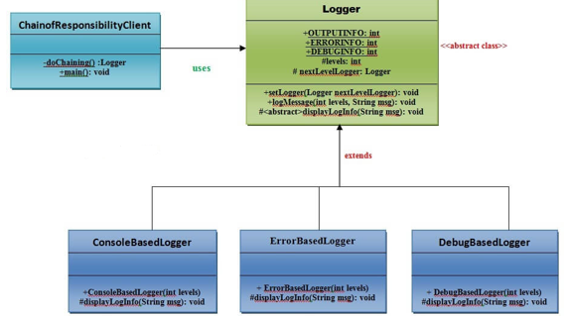
Cont…
UML for Chain of Responsibility Pattern:

Slide 55
Command Pattern
A Command Pattern says that "encapsulate a request under an object as a command and pass it to invoker object. Invoker object looks for the appropriate object which can handle this command and pass the command to the corresponding object and that object executes the command".
It is also known as Action or Transaction.
Advantage of command pattern
It separates the object that invokes the operation from the object that actually performs the operation.
It makes easy to add new commands, because existing classes remain unchanged.

Slide 56
Cont…
Usage of command pattern:
When you need parameterize objects according to an action perform.
When you need to create and execute requests at different times.
When you need to support rollback, logging or transaction functionality.
These are the following participants of the Command Design pattern:
Command This is an interface for executing an operation.
ConcreteCommand This class extends the Command interface and implements the execute method. This class creates a binding between the action and the receiver.
Client This class creates the ConcreteCommand class and associates it with the receiver.
Invoker This class asks the command to carry out the request.
Receiver This class knows to perform the operation.

Slide 57
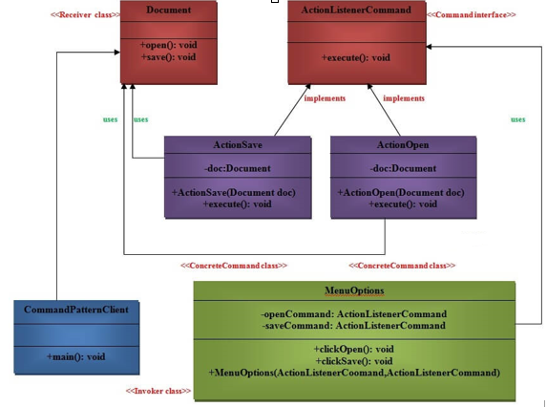
Cont…
UML for command pattern:

Slide 58
Interpreter Pattern
An Interpreter Pattern says that "to define a representation of grammar of a given language, along with an interpreter that uses this representation to interpret sentences in the language".
Basically the Interpreter pattern has limited area where it can be applied. We can discuss the Interpreter pattern only in terms of formal grammars but in this area there are better solutions that is why it is not frequently used.
This pattern can applied for parsing the expressions defined in simple grammars and sometimes in simple rule engines.

Slide 59
Cont…
Advantage of Interpreter Pattern
It is easier to change and extend the grammar.
Implementing the grammar is straightforward.
Usage of Interpreter pattern
When the grammar of the language is not complicated.
When the efficiency is not a priority.

Slide 60
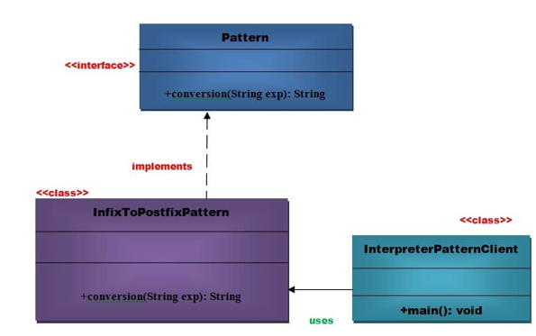
Cont…
UML for Interpreter Pattern

Slide 61
Iterator Pattern
Iterator Pattern is used "to access the elements of an aggregate object sequentially without exposing its underlying implementation".
The Iterator pattern is also known as Cursor.
In collection framework, we are now using Iterator that is preferred over Enumeration.
Advantage of Iterator Pattern
It supports variations in the traversal of a collection.
It simplifies the interface to the collection.

Slide 62
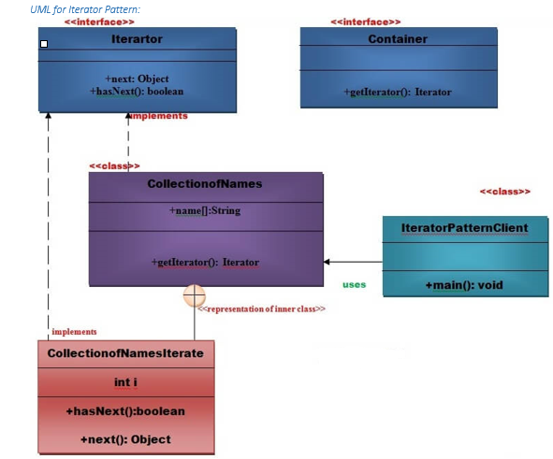
Cont…
Usage of Iterator Pattern
When you want to access a collection of objects without exposing its internal representation.
When there are multiple traversals of objects need to be supported in the collection.

Slide 63
Cont…

Slide 64
Mediator Pattern
A Mediator Pattern says that "to define an object that encapsulates how a set of objects interact".
I will explain the Mediator pattern by considering a problem. When we begin with development, we have a few classes and these classes interact with each other producing results. Now, consider slowly, the logic becomes more complex when functionality increases. Then what happens? We add more classes and they still interact with each other but it gets really difficult to maintain this code now. So, Mediator pattern takes care of this problem.
Mediator pattern is used to reduce communication complexity between multiple objects or classes. This pattern provides a mediator class which normally handles all the communications between different classes and supports easy maintainability of the code by loose coupling.

Slide 65
Cont…
Benefits
It decouples the number of classes.
It simplifies object protocols.
It centralizes the control.
The individual components become simpler and much easier to deal with because they don't need to pass messages to one another.
Usage
It is commonly used in message-based systems likewise chat applications.
When the set of objects communicate in complex but in well-defined ways.

Slide 66
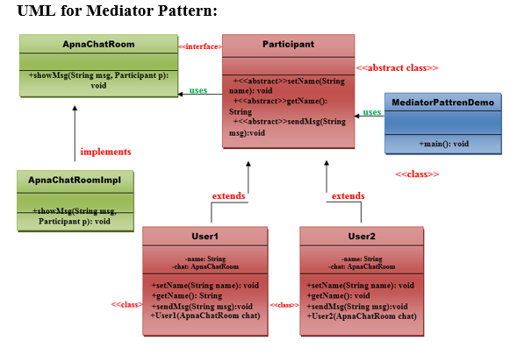
Cont…

Slide 67
Memento Pattern
A Memento Pattern says that "to restore the state of an object to its previous state". But it must do this without violating Encapsulation. Such case is useful in case of error or failure.
The Memento pattern is also known as Token.
Undo or backspace or ctrl+z is one of the most used operation in an editor. Memento design pattern is used to implement the undo operation. This is done by saving the current state of the object as it changes state.
Benefits:
It preserves encapsulation boundaries.
It simplifies the originator.

Slide 68
Cont…
Usage:
It is used in Undo and Redo operations in most software.
It is also used in database transactions.

Slide 69
Observer Pattern
An Observer Pattern says that "just define a one-to-one dependency so that when one object changes state, all its dependents are notified and updated automatically".
The observer pattern is also known as Dependents or Publish-Subscribe.
Benefits:
It describes the coupling between the objects and the observer.
It provides the support for broadcast-type communication.

Slide 70
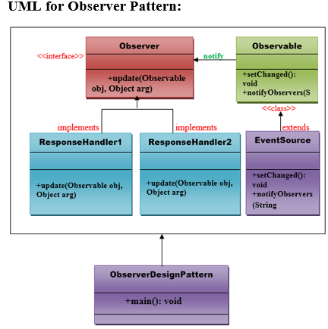
Cont…
Usage:
When the change of a state in one object must be reflected in another object without keeping the objects tight coupled.
When the framework we writes and needs to be enhanced in future with new observers with minimal changes.

Slide 71
State Pattern
A State Pattern says that "the class behavior changes based on its state".
In State Pattern, we create objects which represent various states and a context object whose behavior varies as its state object changes.
The State Pattern is also known as Objects for States.
Benefits:
It keeps the state-specific behavior.
It makes any state transitions explicit.

Slide 72
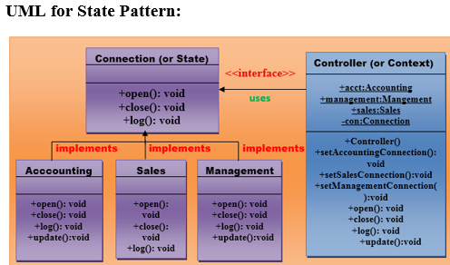
Cont…
Usage:
When the behavior of object depends on its state and it must be able to change its behavior at runtime according to the new state.
It is used when the operations have large, multipart conditional statements that depend on the state of an object

Slide 73
Strategy Pattern
A Strategy Pattern says that "defines a family of functionality, encapsulate each one, and make them interchangeable".
The Strategy Pattern is also known as Policy.
Benefits:
It provides a substitute to sub-classing.
It defines each behavior within its own class, eliminating the need for conditional statements.
It makes it easier to extend and incorporate new behavior without changing the application.
Usage:
When the multiple classes differ only in their behaviors. e.g. Servlet API.
It is used when you need different variations of an algorithm.

Slide 74
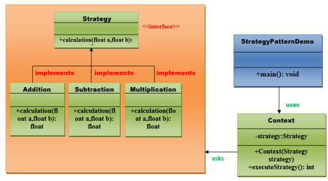
Cont…
UML for Strategy Pattern:

Slide 75
Template Pattern
A Template Pattern says that "just define the skeleton of a function in an operation, deferring some steps to its subclasses".
Benefits:
It is very common technique for reusing the code.
Usage:
It is used when the common behavior among sub-classes should be moved to a single common class by avoiding the duplication.

Slide 76
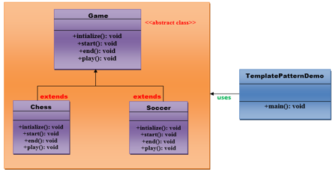
Cont…
UML for Template Pattern:

